Slide 1
Bootloader
1. Function
2. Bootloader on x86
3. Bootloader on embedded system

Slide 2
Bootloader
A boot loader is a computer program that loads the main operating system or runtime environment for the computer after completion of the self-tests.
boot loader is used when the system is powered on, or reset

Slide 3
Function
Bring the operating system kernel (and all the kernel needs to bootstrap) into memory from flash memory, network or another type of non-volatile storage
Provide the kernel with the information it needs to work correctly: check and initialization hardware …
Switch to an environment that the kernel will like
Transfer control to the kernel
Notes:
Besides these basic functions, most bootloaders provide a shell with various commands implementing different operations.
Loading of data from storage or network, memory inspection, hardware diagnostics and testing, etc.
Giving the kernel its information
Some kernels require some extra information to run. Example: the root partition to start from, a map of the address space - effectively a map of where physical memory is and where it's not
Establishing an environment
Most kernels require protected mode. For these kernels you'll have to
Enable A20
Load a GDT
Enter Protected mode
before giving control to the kernel.
It's common for the loader to keep interrupts disabled (the kernel will enable them later when an IDT is properly set up).

Slide 4
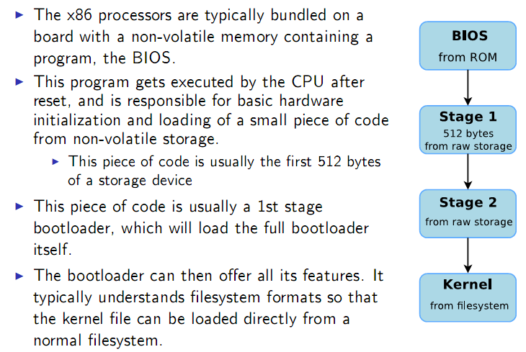
Bootloaders on x86

Slide 5
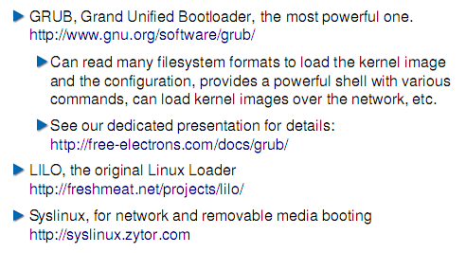
Bootloaders on x86
Notes:
The development of LILO as classic bootloader for GNU/Linux systems was restarted in June 2010. Because of the simpleness LILO has some advantages comparing with Grub and Grub2. But nowadays LILO is not the bootloader for all situations. But LILO is longtime proved and stable.
Removable media: CD-ROM, USB

Slide 6
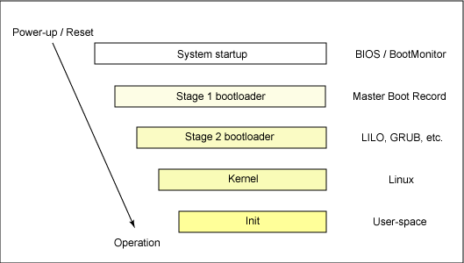
Booting on Linux
Notes:
When a system is first booted, or is reset, the processor executes code in the basic input/output system (BIOS), which is stored in flash memory on the motherboard. CPU in an embedded system invokes the reset vector to start a program at a known address in flash/ROM.
booting Linux begins in the BIOS at address 0xFFFF0
BIOS is the power-on self test (POST):check of the hardware -> local device enumeration and initialization.After the POST is complete, it is flushed from memory, but the BIOS runtime services remain and are available to the target operating system.
boot an operating system:
BIOS: POST code + runtime services
To boot an operating system, the BIOS runtime searches for devices that are both active and bootable in the order of preference defined by the complementary metal oxide semiconductor (CMOS) settings. A boot device can be a floppy disk, a CD-ROM, a partition on a hard disk, a device on the network, or even a USB flash memory stick.
When a boot device is found, the first-stage boot loader is loaded into RAM and executed. This boot loader is less than 512 bytes in length (a single sector), and its job is to load the second-stage boot loader.
When the second-stage boot loader is in RAM and executing, a splash screen is commonly displayed, and Linux and an optional initial RAM disk (temporary root file system) are loaded into memory. When the images are loaded, the second-stage boot loader passes control to the kernel image and the kernel is decompressed and initialized. At this stage, the second-stage boot loader checks the system hardware, enumerates the attached hardware devices, mounts the root device, and then loads the necessary kernel modules. When complete, the first user-space program (init) starts, and high-level system initialization is performed.
That's Linux boot in a nutshell. Now let's dig in a little further and explore some of the details of the Linux boot process.

Slide 7
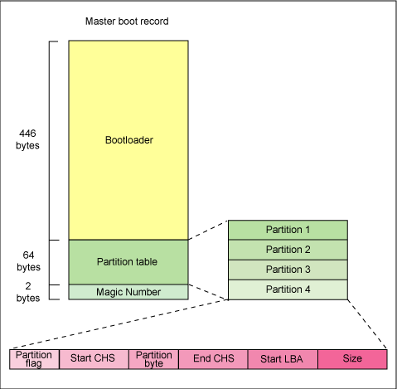
Stage 1 boot loader
Notes:
The primary boot loader that resides in the MBR is a 512-byte image containing both program code and a small partition table (see Figure 2). The first 446 bytes are the primary boot loader, which contains both executable code and error message text. The next sixty-four bytes are the partition table, which contains a record for each of four partitions (sixteen bytes each). The MBR ends with two bytes that are defined as the magic number (0xAA55). The magic number serves as a validation check of the MBR.
The job of the primary boot loader is to find and load the secondary boot loader (stage 2). It does this by looking through the partition table for an active partition. When it finds an active partition, it scans the remaining partitions in the table to ensure that they're all inactive. When this is verified, the active partition's boot record is read from the device into RAM and executed.

Slide 8
Stage 2 boot loader
The task at this stage is to load the Linux kernel and optional initial RAM disk.
GRUB load from an ext2, ext3 file system
With stage 2 boot loader in memory, the file system is consulted, and the default kernel image and initrd image are loaded into memory.
With the images ready, the stage 2 boot loader invokes the kernel image
Notes:
The great thing about GRUB is that it includes knowledge of Linux file systems. Instead of using raw sectors on the disk, as LILO does, GRUB can load a Linux kernel from an ext2 or ext3 file system
GRUB includes the two-stage boot loader into a three-stage boot loader. Stage 1 (MBR) boots a stage 1.5 boot loader that understands the particular file system containing the Linux kernel image. Examples include reiserfs_stage1_5 (to load from a Reiser journaling file system) or e2fs_stage1_5 (to load from an ext2 or ext3 file system). When the stage 1.5 boot loader is loaded and running, the stage 2 boot loader can be loaded.

Slide 9
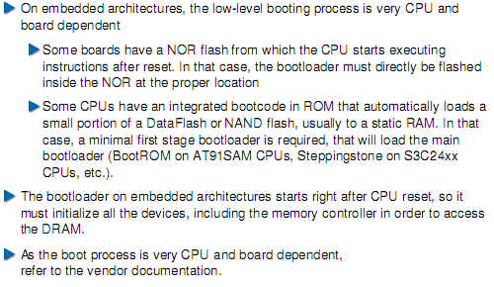
Bootloaders on embedded architectures
Notes:
NOR flash memory is a type of non-volatile storage technology that does not require power to retain data.(NOR gate logic)

Slide 10
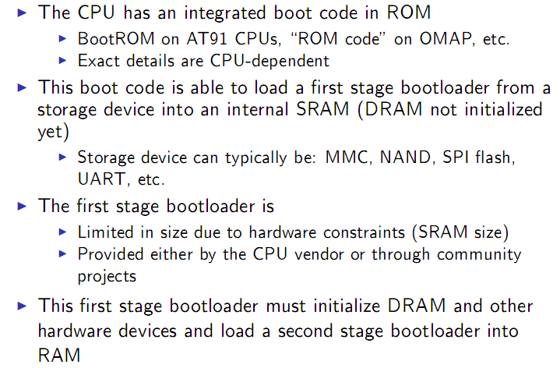
Booting on embedded CPUs

Slide 11
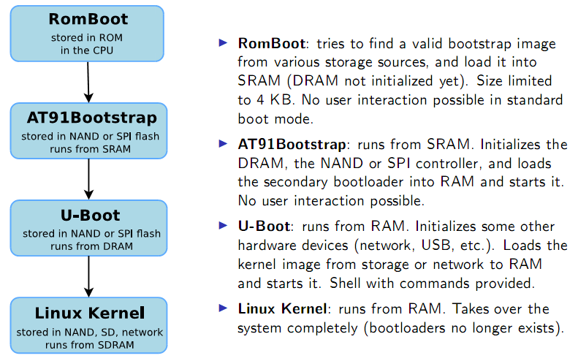
Booting on ARM Atmel AT91

Slide 12
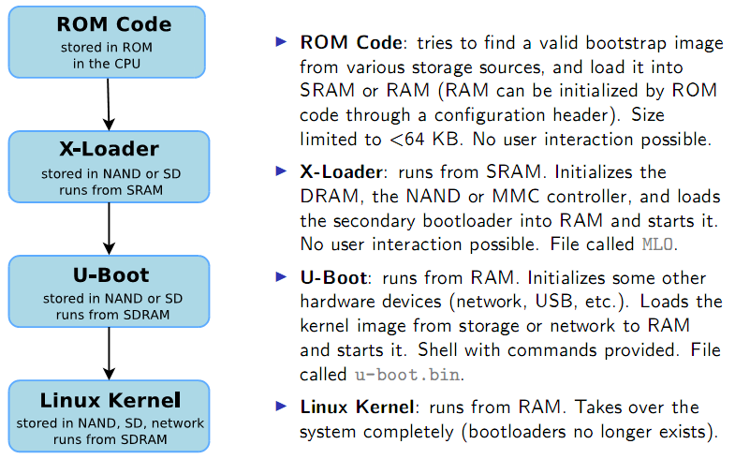
Booting on ARM OMAP3

Slide 13
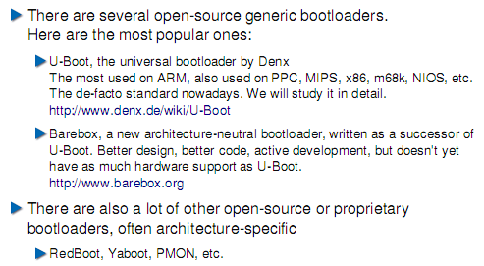
Generic bootloaders for embedded CPUs

